Slide 1


.NET Standard
Isaac Levin
Notes:
Welcome to .NET Workshop. In this overview session, I would like to set the stage for this workshop with the current landscape on how to build apps with .NET

Slide 2
.NET today—reusing code
.NET FRAMEWORK
.NET
XAMARIN
APP
MODELS
WPF
Windows Forms
UWP
iOS
Android
ASP.NET
ASP.NET Core
OS X
BASE
LIBRARIES
.NET Framework BCL
.NET Core BCL
Mono BCL

Slide 3
.NET today—reusing code
.NET FRAMEWORK
.NET
XAMARIN
CHALLENGES
Difficult to reuse skills
Need to master 3+1 base class libraries
Difficult to reuse code
Need to target a fairly small common denominator
Difficult to innovate
Need implementations on each platform
APP
MODELS
WPF
Windows Forms
UWP
iOS
Android
ASP.NET
ASP.NET Core
OS X
BASE
LIBRARIES
.NET Framework BCL
.NET Core BCL
Mono BCL

Slide 4
.NET tomorrow
.NET FRAMEWORK
.NET
APP
MODELS
WPF
Windows Forms
Windows
Android
macOS
ASP.NET
ASP.NET Core
iOS
IoT
BASE
LIBRARIES
.NET Standard

Slide 5
.NET tomorrow
.NET FRAMEWORK
.NET
BENEFITS
Reuse skills
Master one BCL, not a Venn diagram
Reuse code
Common denominator is much bigger
Faster innovation
Target .NET Standard & run anywhere
APP
MODELS
WPF
Windows Forms
Windows
Android
macOS
ASP.NET
ASP.NET Core
iOS
IoT
BASE
LIBRARIES
.NET Standard

Slide 6
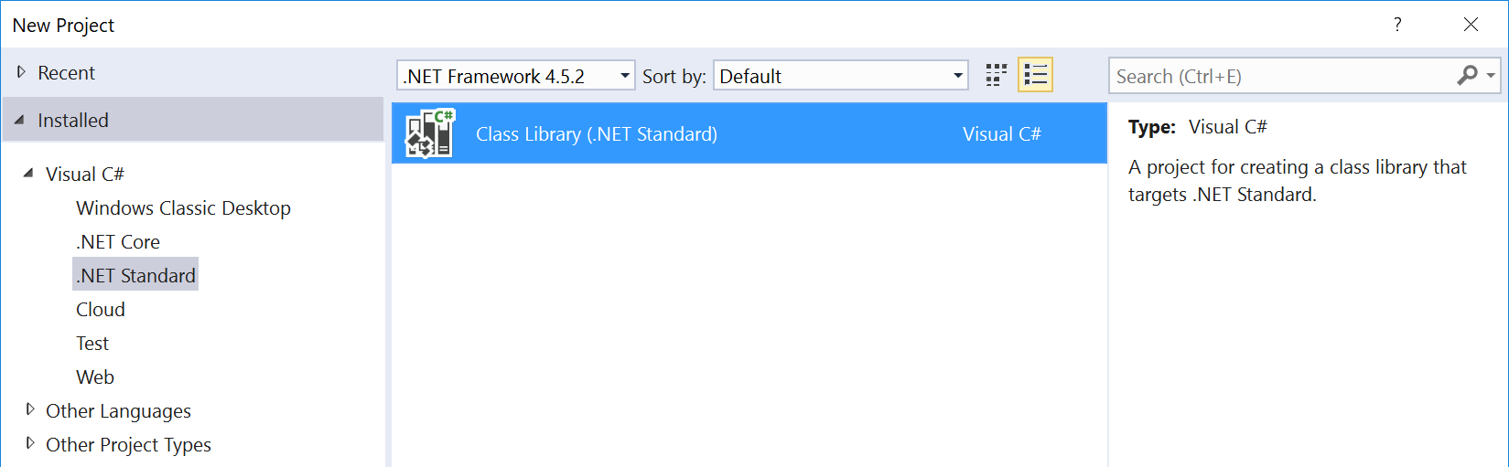
What is .NET Standard?
.NET Standard is a specification
A set of APIs that all .NET platforms have to implement
.NET Standard
.NET Framework
.NET
~
~
HTML specification
Browsers

Slide 7
.NET Standard 2.0
Has much bigger API surface
Extended to cover intersection between .NET Framework and .NET 6
Makes .NET 6 bigger as it implements more Apis than .NET Standard 2.0
+20K
More APIs than
.NET Standard 1.x
Can reference .NET Framework libraries
Compat shim allows referencing existing .NET Framework code – without recompilation
Limited to libs that use APIs that are available for .NET Standard
~70%
of NuGet packages
are API compatible

Slide 8
Demo
Looking at .NET Standard

Slide 9
Demo
Exploring .NET Standard Versions

Slide 10
What version should you target?
The higher the version, the more APIs you have
The lower the version, the more platforms support it
Target the lowest version you can get away with!
Lower Version
Higher Version
More Reach
More APIs

Slide 11
Demo
Multi-Targeting with .NET Standard

Slide 12
Questions?
The future of .NET Standard - .NET Blog (microsoft.com)

Slide 13
How does .NET Standard work?
.NET Standard is represented by
The NuGet package NetStandard.Library which contains
The reference assembly netstandard.dll
At build time
.NET Standard bridges references to existing .NET Framework and PCL assemblies via type forwarding
At runtime
Each platform provides an implementation for netstandard.dll that type forwards to its implementation

Slide 14
What can you reference from .NET Standard?
.NET FRAMEWORK
.NET CORE
XAMARIN
Legend
My Standard Library 2.x
Is able to reference
Application Type
Via Portability
.NET Standard Library
Portable Class Library
.NET Framework Library
Via Compatibility Shim

Slide 15
.NET Standard under the hood
YOUR .NET STANDARD-BASED CLASS LIBRARY
NETSTANDARD.DLL
TYPE
FORWARDING
.NET FRAMEWORK OR PORTABLE CLASS LIBRARY
EXISTING .NET FRAMEWORK CLASS LIBRARY
MSCORLIB.DLL
MSCORLIB.DLL
MSCORLIB.DLL
FRAMEWORK ASSEMBLIES
This happens when you build a .NET Standard-based Library

Slide 16
.NET Standard under the hood
YOUR .NET APPLICATION
FRAMEWORK ASSEMBLIES
TYPE
FORWARDING
YOUR .NET STANDARD-BASED CLASS LIBRARY
NETSTANDARD.DLL
This happens when you load .NET Standard-based library

Slide 17
Platform specific APIs & .NET Standard
.NET Standard (mostly) only contains APIs that will work everywhere
We generally avoid adding large chunks of APIs that don’t work everywhere
A small set of APIs will throw PlatformNotSupportedException
Platform specific APIs sit on top of .NET Standard & you can add references to them
Examples: Registry, Reflection Emit, Access Control, Windows Identity
You’ll become less portable

Slide 18
Platform specific APIs & .NET Standard
YOUR .NET STANDARD-BASED CLASS LIBRARY
NETSTANDARD.DLL
TYPE
FORWARDING
TYPE
FORWARDING
PLATFORM-SPECIFIC EXTENSION
REGISTRY.DLL
MSCORLIB.DLL
MSCORLIB.DLL
MSCORLIB.DLL
FRAMEWORK ASSEMBLIES
This happens when you build a .NET Standard-based library with platform-specific extensions

Slide 19
Platform specific APIs & .NET Standard
YOUR .NET APPLICATION
FRAMEWORK ASSEMBLIES
YOUR .NET STANDARD-BASED CLASS LIBRARY
SUPPORTED EXTENSION
TYPE
FORWARDING
EXCEPTION
UNSUPPORTED EXTENSION
This happens when you load .NET Standard-based library with platform-specific extensions

Slide 20
What about the breaking change?
.NET Framework 4.6.1 will have the broadest adoption when we ship
Doesn’t support all the APIs in 1.6 (~100 are missing) but
Does supports most of the additions in .NET Standard 2.0
We considered not exposing the missing APIs in .NET Standard 2.0:
No breaking change between
.NET Standard 1.x and 2.0!
.NET Standard | 1.0 | 1.1 | 1.2 | 1.3 | 1.4 | 1.5 | 1.6 | 2.0
.NET Framework | → | 4.5 | 4.5.1 | 4.6 | 4.6.1 | 4.6.2 | vNext | 4.6.1
.NET Framework | → | 4.5 | 4.5.1 | 4.6 | → | → | → | 4.6.1

Slide 21
What’s new in .NET Standard 2.0?
Many more APIs!
Compat with .NET Framework libs!
.NET standard 2.0 more than doubles the number of APIs!
Most libraries are still targeting .NET Framework
A compat shim makes them usable on other platforms, with caveats
Version | #APIs | Growth %
1.x | 13,501 | +1%
2.0 | 32,638 | +142%
Target | Usage on NuGet
.NET Framework | 46,894
.NET Standard | 1,886
PCL | 4,501

Slide 22
.NET Core and .NET Standard
.NET Core is an implementation of the .NET Standard
They are fully separated, e.g. different GitHub repositories
.NET Standard updates are coordinated across all .NET implementers
There is a .NET Standard review board
.NET Core can be updated independently
Used by us to experiment and accelerate innovation

Slide 23
.NET Core & .NET Standard Releases
.NET Core 1.0
June 2016
VS 2017
Feb 2017
.NET Core 2.0
.NET Standard 2.0
August 2017
.NET Core 1.1
October 2016

Slide 24
Difference to Portable Class Libraries (PCL)
PCLs were an after thought, i.e. each platform could decide which APIs to includes
No systematic approach to versioning
Computed intersection profiles
Each PCLs is targeting a specific set of platforms
Not compatible with newer platforms
Hard to understand compatibility relationships
PCLs are now deprecated. Use .NET Standard!
Platform 1
Platform 3
Platform 2
Intersection Profiles

Slide 25
Versioning in .NET Standard
Higher versions incorporate all APIs from previous versions.
Projects targeting version X.Y can reference libraries & projects targeting any version between 1.0 and X.Y
Concrete .NET platforms implement a specific version of .NET Standard
From that platform you can reference libraries up to that version
2.0
1.6
1.3
1.0

